Slide 1
Fokir Marka Airlines LTD.
"Your Comfort and Safety is Our Priority"

Slide 2
"About the System"
# | A C-based airline reservation system.
# | Handles reservations, cancellations, seat status, and revenue tracking.
# | User authentication ensures system security.
# | User-friendly menu-driven interface.
# | Discounts for students and senior citizens.
# | Automated seat allocation and availability tracking.

Slide 3
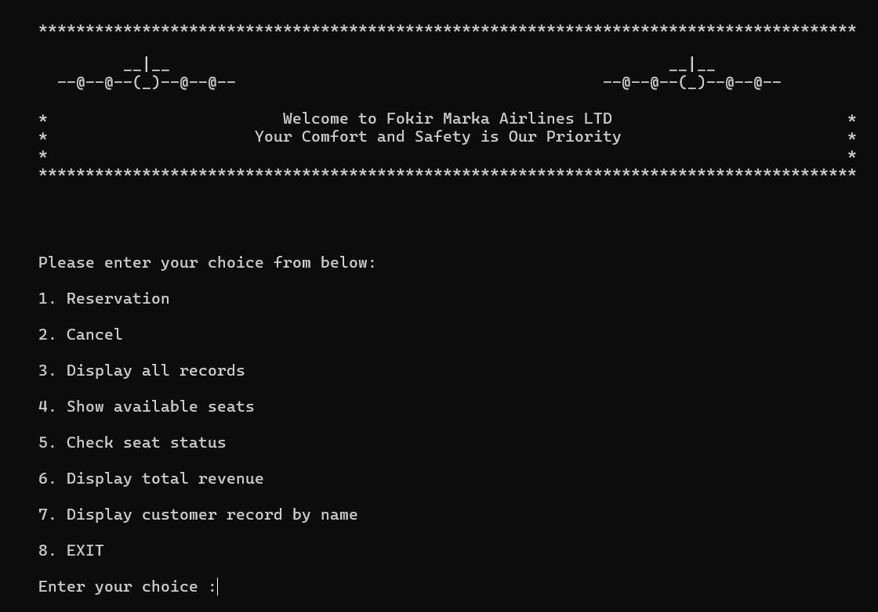
"Features of the System"
User login with multiple accounts.
Automated seat allocation.
Discount calculation for eligible users.
Menu-driven operations for ease of use.

Slide 4
Table of contents
01
Reservation
02
06
Cancellation
Revenue And Customers Record
03
05
04
Display Records
Seat Status
Available Seats
08
07
Conclusion
Limitations

Slide 5
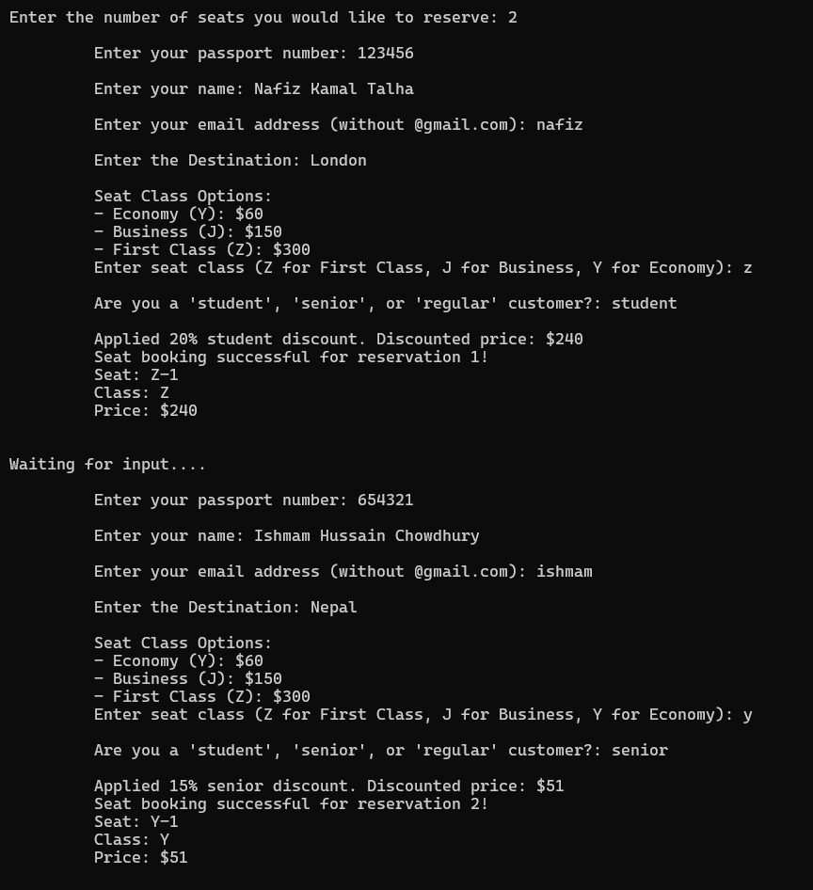
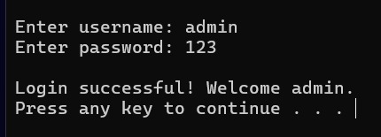
01
Reservation

Slide 6
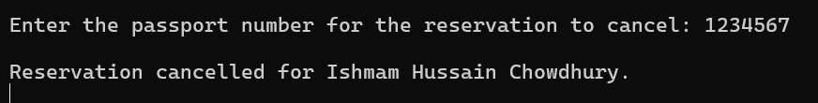
02
Cancellation

Slide 7
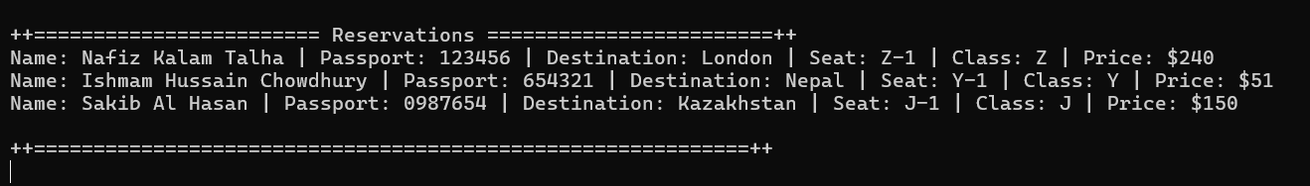
03
Display Records

Slide 8
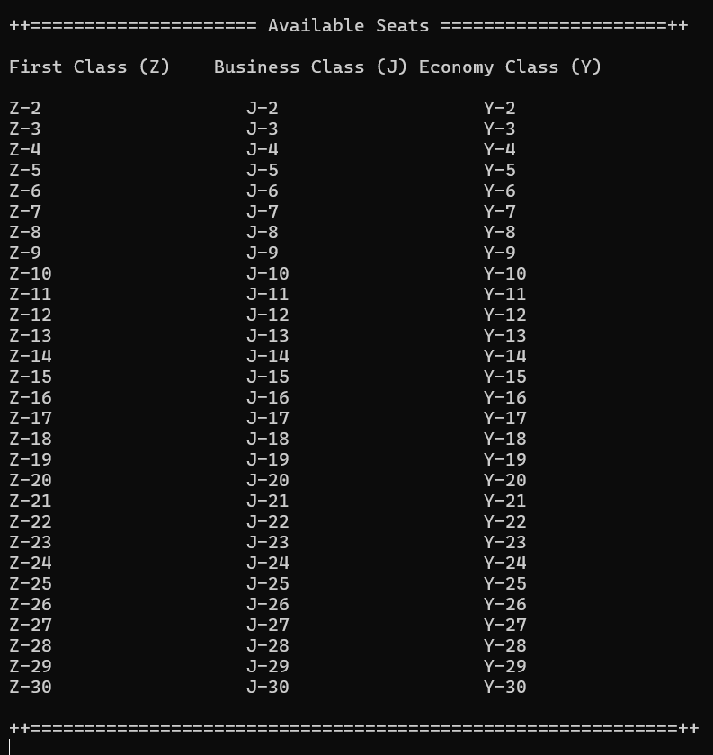
04
Available Seats

Slide 9
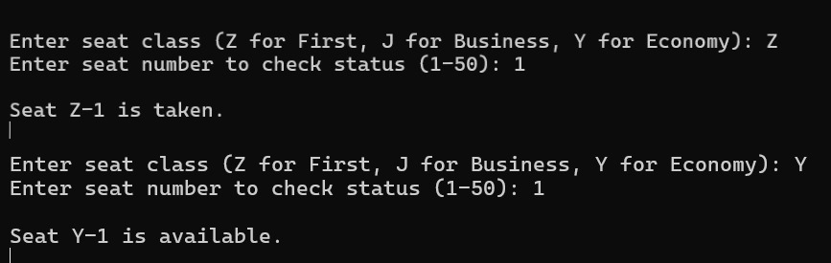
05
Seat Status

Slide 10
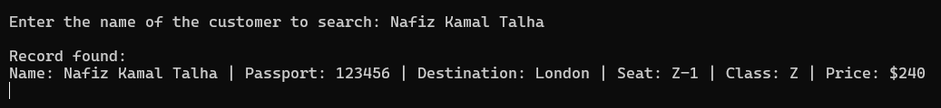
06
Revenue And Customers Record

Slide 11
Limitations
07
No Data Persistence: Reservations are lost after the program exits; no database or file storage.
Limited Features: Fixed seat count, single-flight management, and no route or schedule support.
Weak Security: Plain-text passwords and unencrypted sensitive data.
Basic User Management: Hardcoded user accounts with no dynamic registration or updates.
Rigid Seat Allocation: No option to select specific seats.
Lack of Validation: Inputs like emails and passport numbers aren't validated.
No Integration: Missing payment gateways and notification systems.

Slide 12
08
Conclusion
This program offers a fundamental yet functional airline reservation system, covering essential features such as seat booking, cancellations, revenue tracking, and seat availability checks. It incorporates user authentication and discounts to enhance usability and customer satisfaction. While the system provides a solid foundation for managing reservations efficiently, its limitations, such as lack of data persistence, limited scalability, and basic input validation, highlight areas for further development. With enhancements like database integration, robust input handling, and expanded flight options, this program could evolve into a comprehensive solution for airline reservation management.

Slide 13
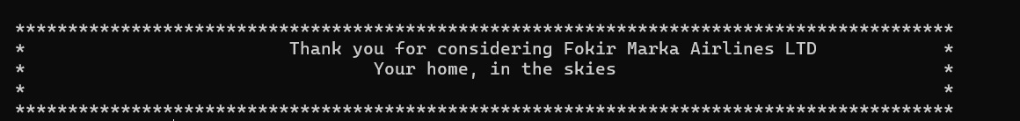
Thanks for Your Patience!
Ishmam Hussain Chowdhury
ID : 232-115 -357
Nafiz Kamal Talha
ID : 232-115-365
Sakib Al Hasan
ID : 232-115-366

